Slide 1
Rich Family Genealogy . . .
A Work in Progress
Presented by:
Marcia Call (mcall0912@gmail.com, 703.819.4569)
Holt Huddle, Fall Creek Falls State Park, Tennessee
July 8, 2023

Slide 2
Table of Contents
Introduction
C. S. Rich and Vera Farmer
Edward W. Rich and Margaret Jane Meadows
Stephen C. Rich II and Eliza West
Stephen C. Rich I and Phariby Overstreet
Research Interests

Slide 3
Introduction

Slide 4
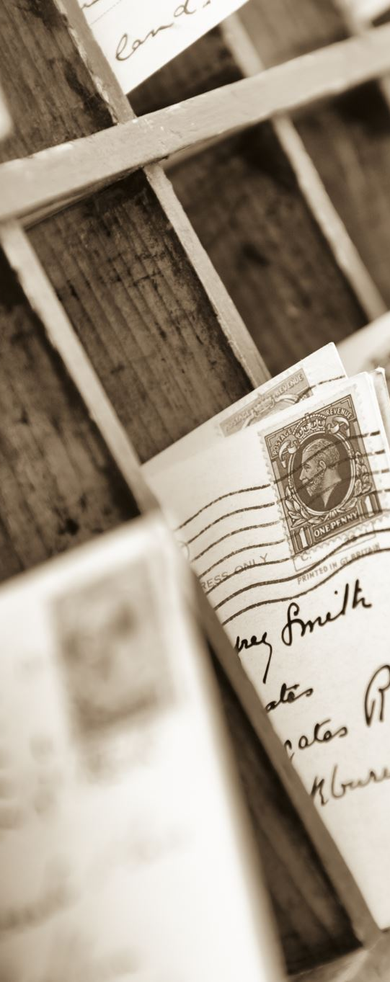
How I Got Started . . .
COVID
Started cleaning out closets and boxes
Had to read everything to figure out where it belonged
Started scanning and sorting
Signed up for Ancestry
I was HOOKED!

Slide 5
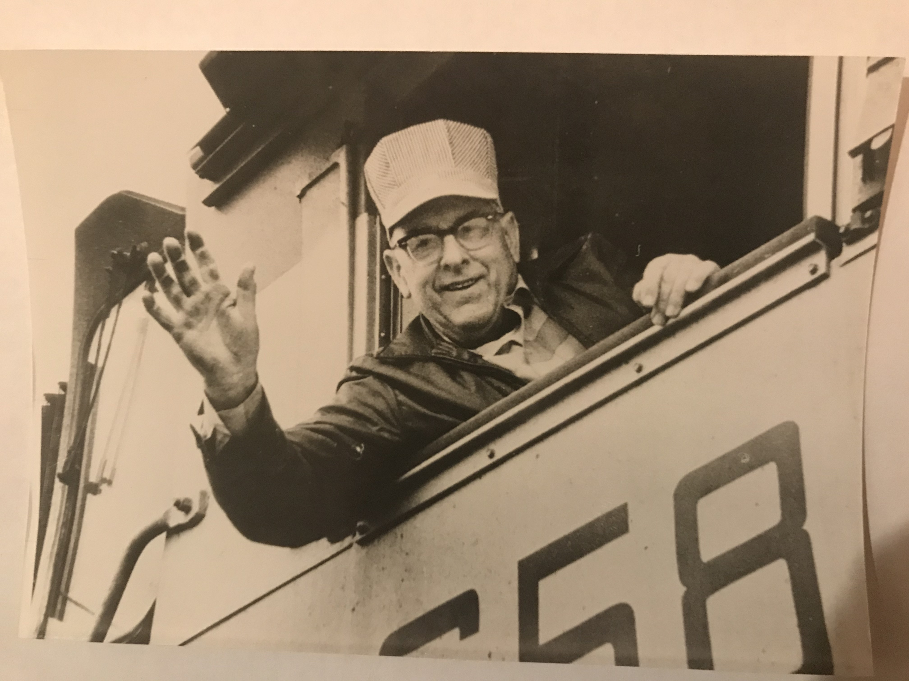
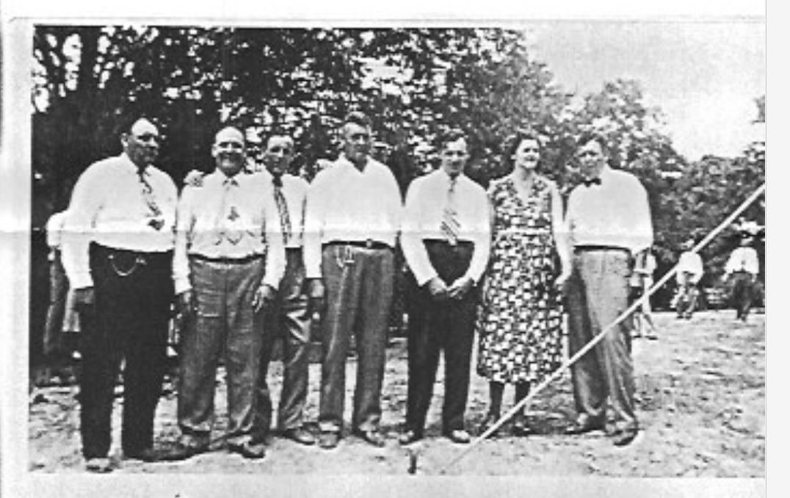
Lathern Smith, Our Rich Family Genealogist
Lathern Smith, was Daddy Windy’s first cousin. Pictured below in birth order: Lathern and siblings Leslie, Willard, Monroe, Woodrow, Gretel, and Dale.
Lathern’s favorite picture -- His final run, November 30, 1971, from Mobile to York, Alabama for the Alabama, Tennessee, and Northern Railroad Corporation.

Slide 6
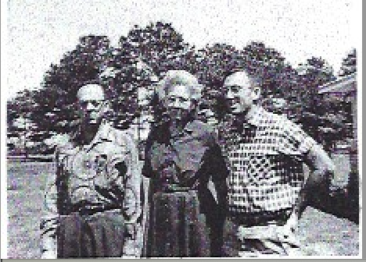
Daddy Windy, Mama Rich, and Uncle Ellis
The Family We Knew . . .

Slide 7
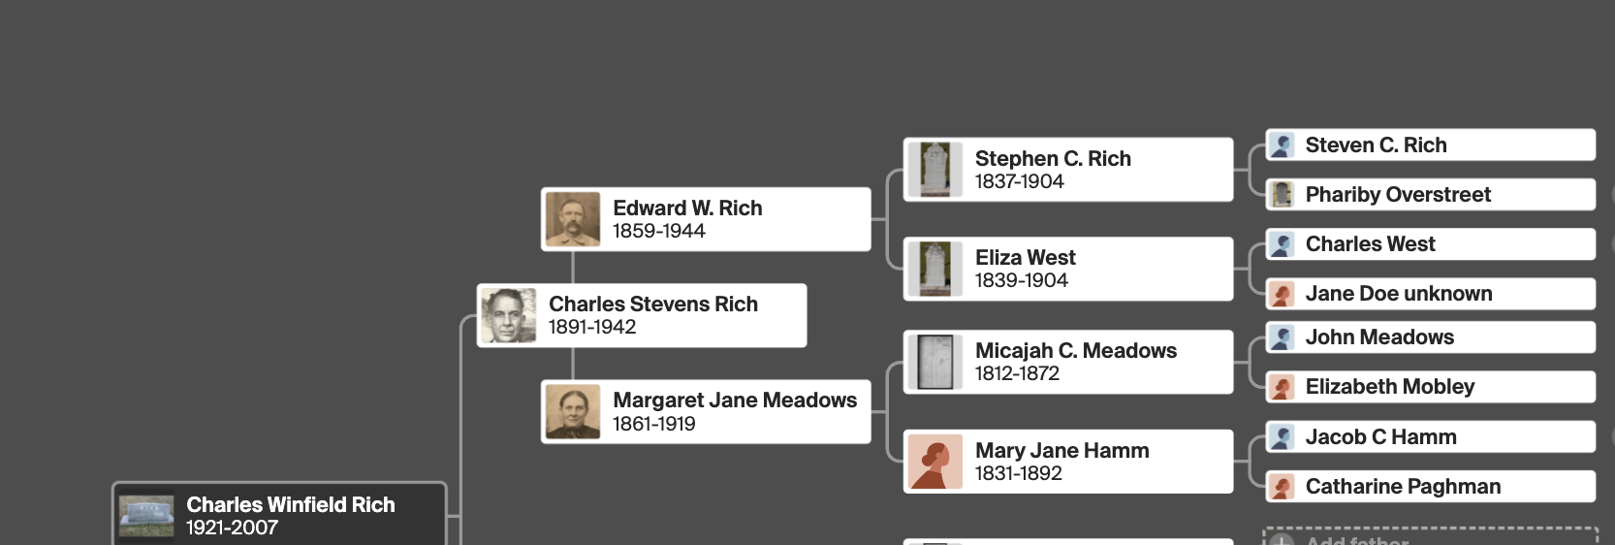
C. S. Rich and Vera Farmer

Slide 8
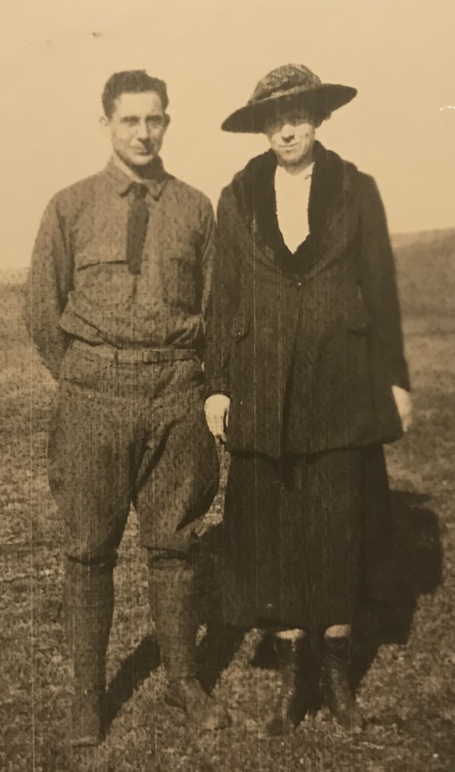
Charles Stevens Rich and Vera Vashti Farmer
What we know about C. S. Rich:
Born 1891 in Isney, Alabama
Attended Jones County Agricultural High School 1912-14
Ran the U.S. Experiment Station at West Point, Mississippi for 15 years (1925-1940)
Left job because of health (injuries and surgeries)
Reapplied for his job in 1941; did not win it back
Divorced from Vera in 1941
Died February 1942 at home of brother, Alex

Slide 9
Charles Stevens Rich and Vera Vashti Farmer
What we know about Vera Vashti Farmer:
Born 1892 in Macon, Mississippi
Attended ”Industrial Institute for White Girls” (renamed Mississippi Women’s College”)
Married in 1919
Divorced C. S. in 1941 (“cruelty and intolerable treatment”)
Was a “home demonstration agent” for 50 years
Traveled to Hawaii for 50th Anniversary of the National Extension Homemaker’s Council in 1964
Died December 1964 in Columbus, Mississippi
NOTE: We have her bible.

Slide 10
Edward Rich and
Margaret Jane Meadows

Slide 11
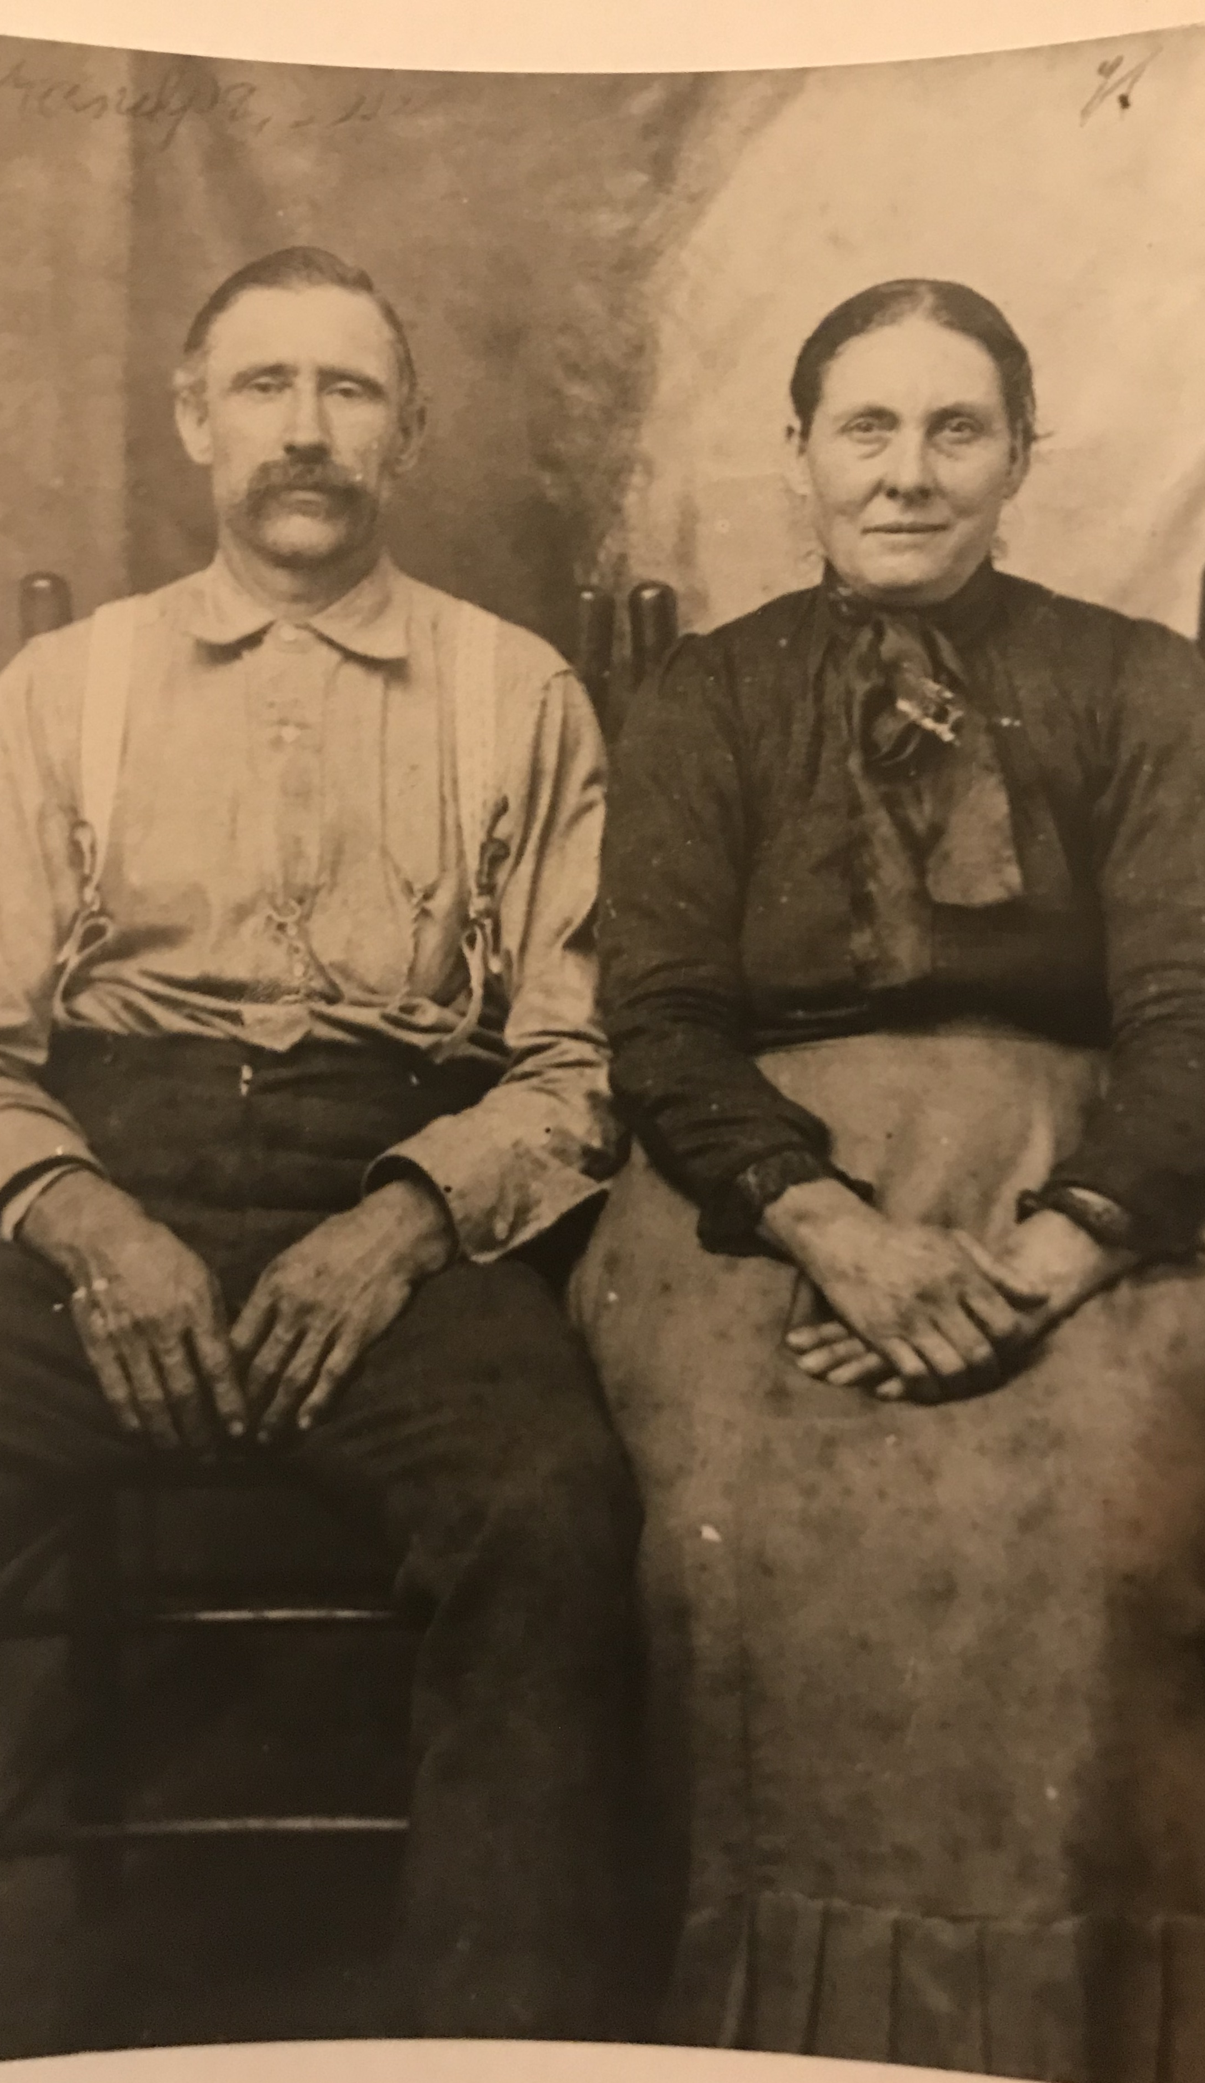
Edward W. Rich and Margaret Jane Meadows (From Rebecca Smith told to son, Lathern)
What we know about Edward W. Rich:
Born 1859 in Richton, Perry County, Mississippi
Married Margaret Jane Meadows in 1879
Considered a wealthy man – 1,000 acres, 10 wagons, 10 teams of 5-yokes of oxen (50!)
Had 11 children (1880 – 1900) – 7 boys, 4 girls
Children: Rebecca, Samuel, Steven C., Mary, Martha, Alex, Charles, Henry, Eliza, Mary Jane (Josie), Walter Lee
Lathern said he married 6 more times and had more children
Died in 1944; buried in Frisco Cemetery

Slide 12
Edward W. Rich and Margaret Jane Meadows (From Rebecca Smith told to son, Lathern)
What we know about Margaret Jane Meadows:
Born 1861 in Richton, Perry County, Mississippi
Married Edward W. Rich in 1879
Had 11 children (1880 – 1900) – 7 boys, 4 girls
Described by Lathern’s mother, Rebecca, as “sweetest woman who ever lived”
Died in 1915
Lived and died in Richton; buried in Frisco Cemetery

Slide 13
What do we know about the kids?
11 children (1880 – 1900) – 7 boys, 4 girls
Names: Rebecca, Samuel, Steven C. III, Mary, Martha, Arthur Alexander, C.S., Henry, Eliza, Joseph, Walter
Lathern’s mother, Rebecca, was the oldest (b. 1880)
Samuel (b. 1881) said to have been whipped by father with a chain and died few days later (Lathern) in 1897
Mary Rich (b./d. 1886)
Martha Rich (b. 1888) died at the age of 12 sweeping embers when her dress caught on fire
C. S. Rich (b. 1891) was #7 and his closest sibling was #6, Alex (b. 1889)
Daddy and Uncle Ellis had over 25 Rich first cousins!

Slide 14
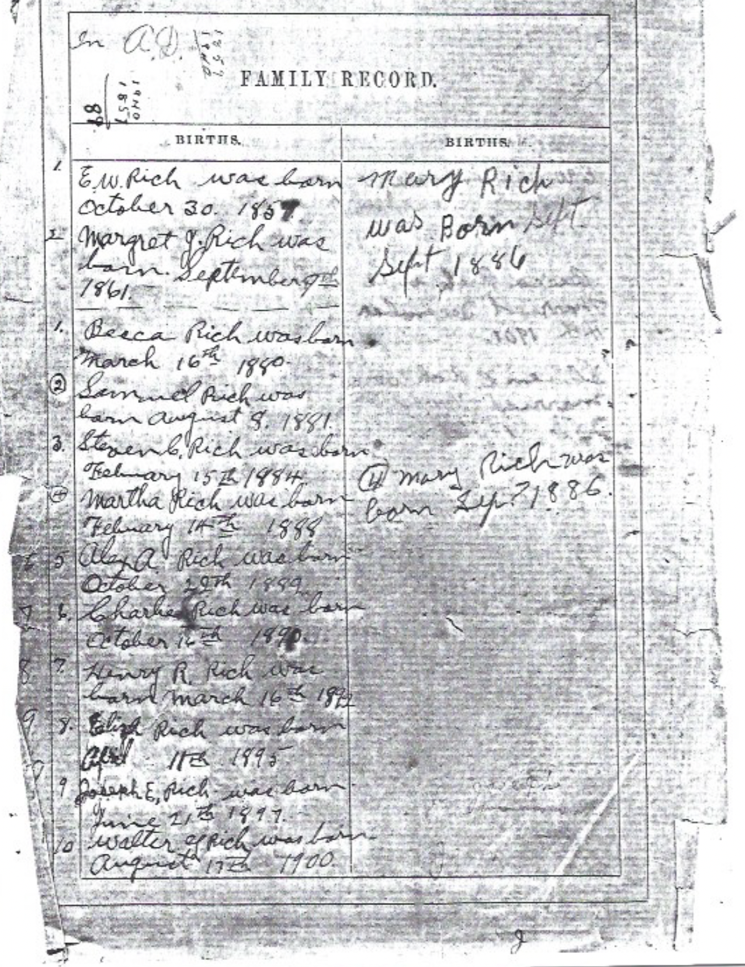
Edward W. Rich’s Bible
Column 1:
E.W. Rich was born October 30, 1859
Margret J. Rich was born September 9th 1861.
Becca Rich was born March 16th 1880
Samuel Rich was born August 8, 1881
Stephen C. Rich was born February 15th, 1884
Martha Rich was born February 14th, 1888
Alex A. Rich was born October 29th 1889
Charles Rich was born October 16th 1890
Henry R. Rich was born March 16th 1892
Eliza Rich was born April 11th 1895
Joseph E. Rich was born June 21st 1897
Walter L. Rich was born August 17th 1900
Column 2:
Mary Rich was born Sept
Sept 1886
4. Mary Rich was born Sep ? 1886

Slide 15
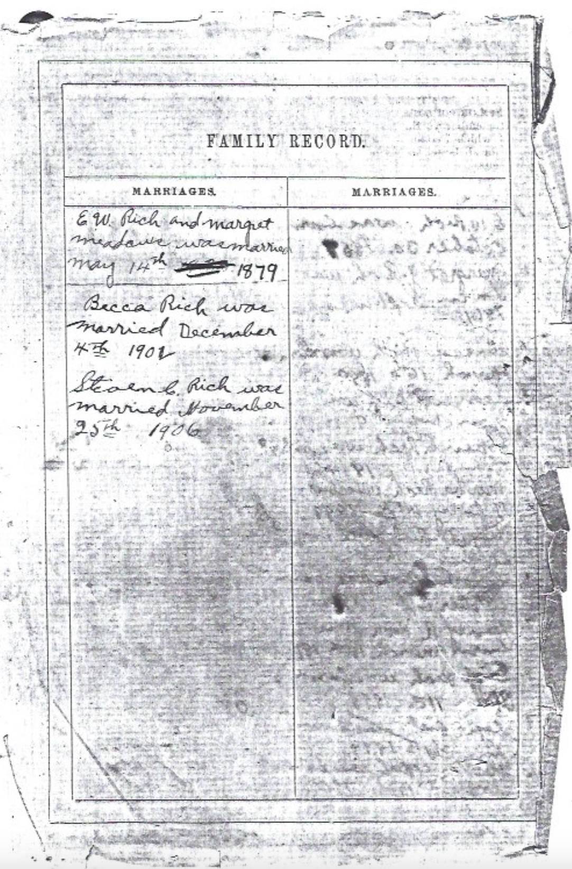
Edward W. Rich’s Bible
E.W. Rich and Margret Meadows was married May 14th 1879
_______________
Becca Rich was married December 4th 1902
Steven C. Rich was married November 25th 1906

Slide 16
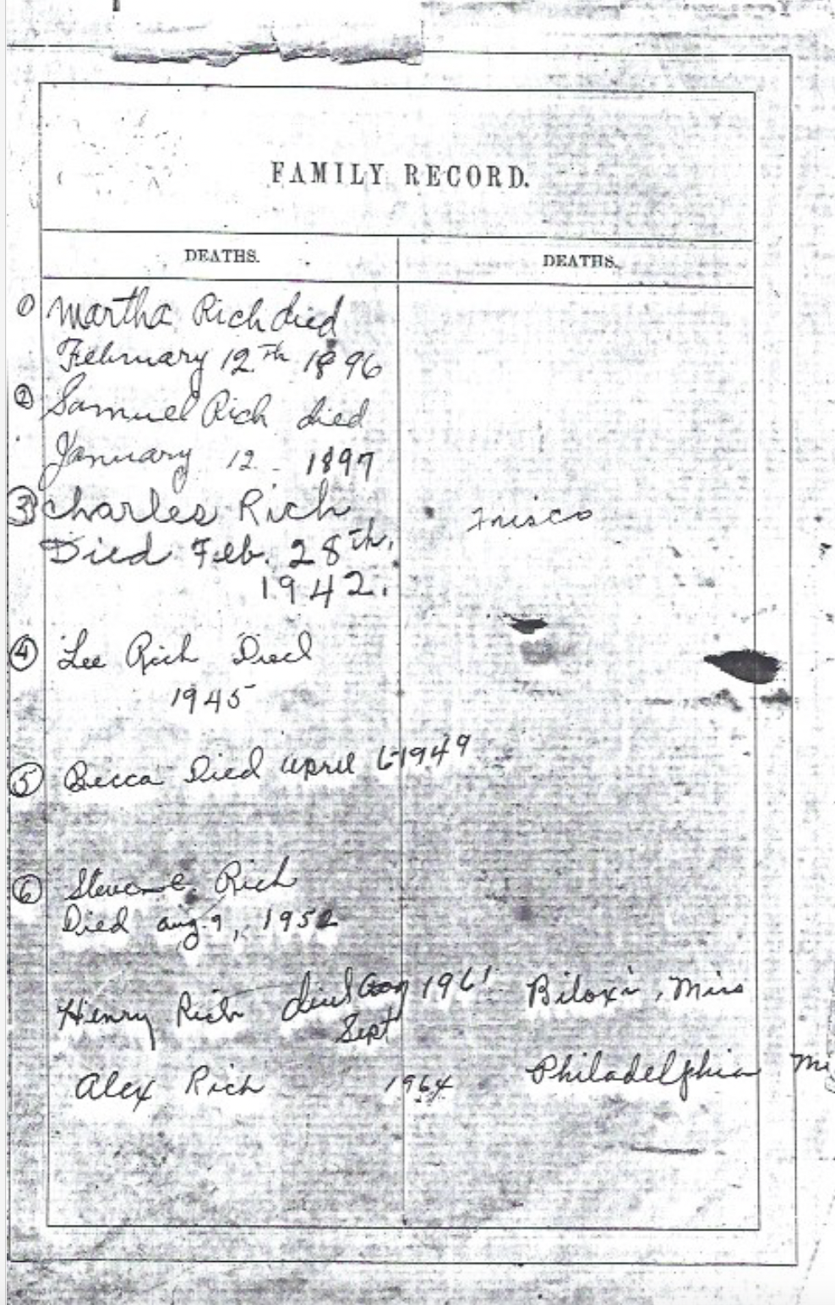
Edward W. Rich’s Bible
Column 1/2
Martha Rich died February 12th 1896
Samuel Rich died January 12. 1897
Charles Rich Died Feb. 28th, 1942.
Lee Rich Died 1945
Becca Died April 6-1949
Stephen Rich Died Aug. 9, 1952
Henry Rich died Aug Sept 1961 Biloxi Miss
Alex Rich 1964 Philadelphia Mi

Slide 17
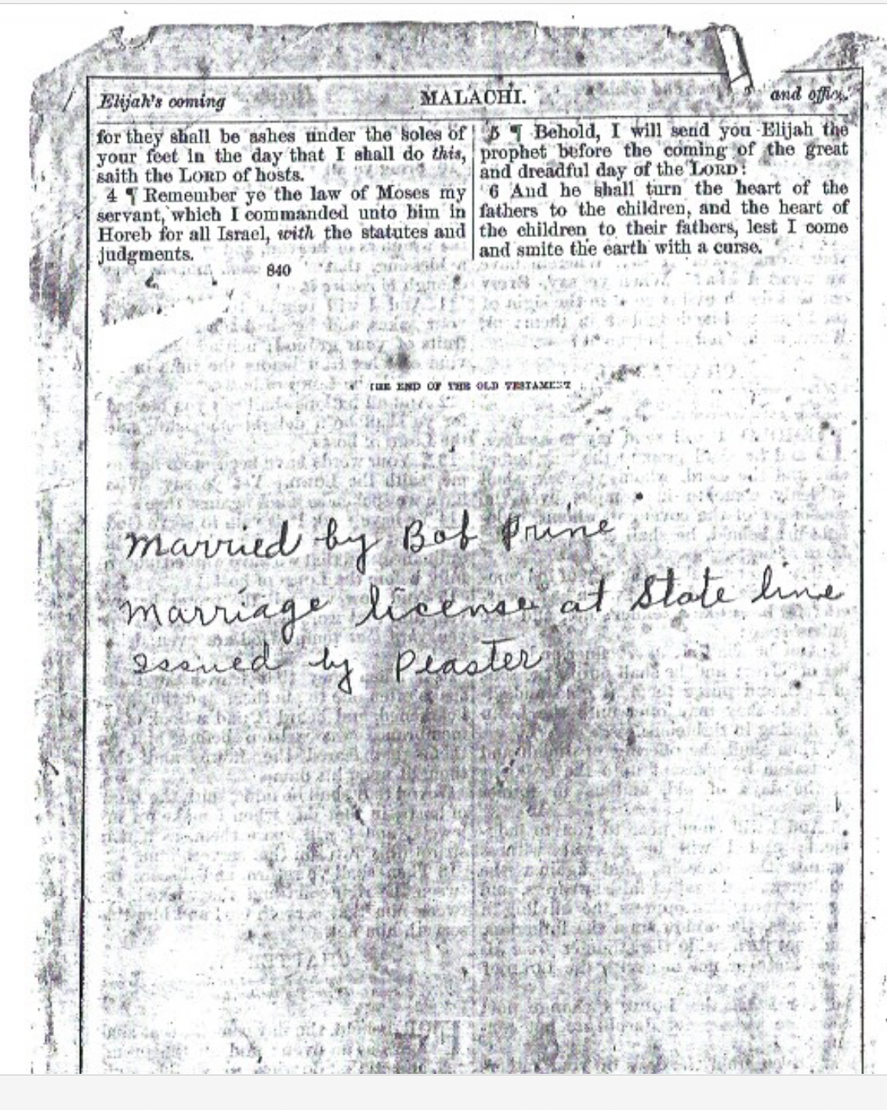
Edward W. Rich’s Bible
Column 1/2
married by Bob Prine
Marriage license at state line
Issued by Peaster
*possession of Dianne Rich Goodnight (Stephen C. Rich III’s granddaughter, Lonnie/Sam/Robert’s 2nd cousin)

Slide 18
Stephen Rich II and Eliza West

Slide 19
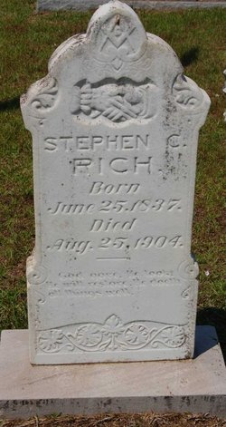
Stephen C. Rich II
What we know about Stephen C. Rich II:
Born 1837 in Ellisville, Perry County, Mississippi
Married in 1859/60
Served in the Civil War as a Confederate soldier(1862-1865 with 2 different units)
Dammed Thompson Creek and created Rich’s Mill (Richton)
Had 10 children with Eliza – 1859 – 1880
Died 1904; buried in Richton at Frisco
What we don’t know:
Where he came from
Who his parents were . . . SPECULATION!

Slide 20
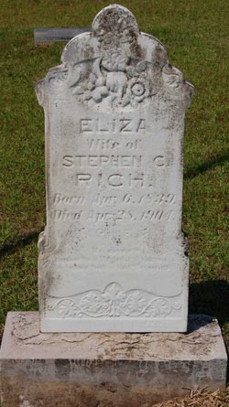
Eliza West
What we know about Eliza West:
Born 1839 in Greene County, Mississippi
Both father (Charles) and mother were dead by 1848
Adopted by Uncle Willis Hayes West along with her 3 sisters; moved to Clarke County
Married in 1859/60
Had 10 children (1859 – 1880)
Died 1904; buried in Richton at Frisco
What we don’t know:
Who her mother was
NOTE: I could do a whole presentation on Eliza’s family thanks to Judy Robson West!

Slide 21
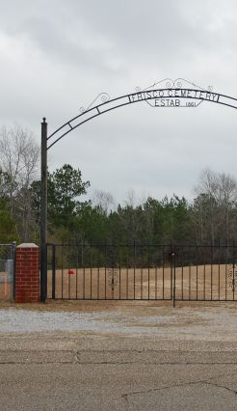
What do we know about the kids?
10 children (1859-1880) – 6 boys, 4 girls
Names: Edward, Charles, Martha, William, Nancy, James, John, Kosciusko, Stephen, Mary Jane
Ed, Daddy Windy’s grandfather, was the oldest (b. 1859)
Nancy (b. 1867) killed her brother, John, (b. 1872) in 1903 over their father’s estate – water rights
Daddy Windy’s father, C. S. Rich, had over 30 Rich first cousins!

Slide 22
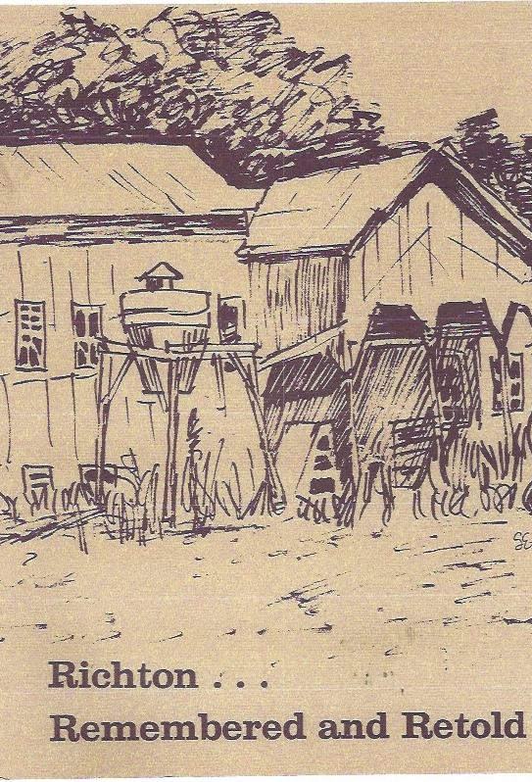
Rolling Back Time to . . .
Richton, Perry County, Mississippi
Published in 1976
Originally Choctaw land
Discovered by DeSoto in 1500s
1805 Mississippi acquires land
First settlers in 1809
One BIG county known as Washington
1817 Mississippi statehood
1850s Riches, Hintons, Holimans, Mills, and Walleys arrive
Lynn Stevens McMullan’s family arrives in 1903!

Slide 23
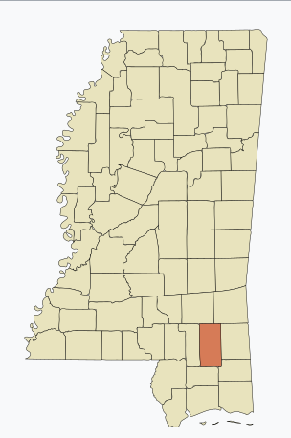
Where is Richton, Mississippi?
350 miles south of Milan, TN
230 miles south of Starkville, MS
100 miles southeast of Jackson, MS
20 miles east of Hattiesburg, MS
80 miles north of Biloxi, MS

Slide 24
Stephen Rich I and
Phariby Overstreet

Slide 25
Who are you?
Probably from North Carolina
Probably father of Stephen C. Rich II PLUS 2 other sons – Peter and Jacob
May have died in his 30s
Wife? Lathern says Hilda Hinton; Lonnie’s DNA matches and censuses suggest Phariby Overstreet
Who is Phariby? Phariby’s father was Braswell Overstreet who is reputed to have married Sara Bowie, a half-Creek Indian
Phariby married Thomas Taylor and had 9 more children
More research is needed. No marriage records, burnt records, etc.
?

Slide 26
Research Interests

Slide 27
Research Interests?
STEPHEN C. RICH I:
Where did Stephen C. Rich I come from? NC? SC?
Who did Stephen C. Rich I marry? Hinton or Overstreet?
What do we know about either Hintons or Overstreets?
STEPHEN C. RICH II:
Where did Stephen C. Rich II come from? NC? SC?
How did Eliza West’s parents die?
What was her mother’s name?
EDWARD W. RICH:
How did Margaret Jane Meadows’ father Micajah (Ed Rich’s wife) end up marrying Mary Jane Hamm from New York?
What do we know about the Hamms?
GENERAL:
Are the Wests in the Holt line related to the Wests in the Rich line?
Was John Sterling West one of the four legislators in the MS legislature to vote against secession? What do we know about him?
Did we hold slaves? If so, who and how many? What do we know about them?

Slide 28
WHAT DO YOU WANT TO KNOW?

